Slide 1
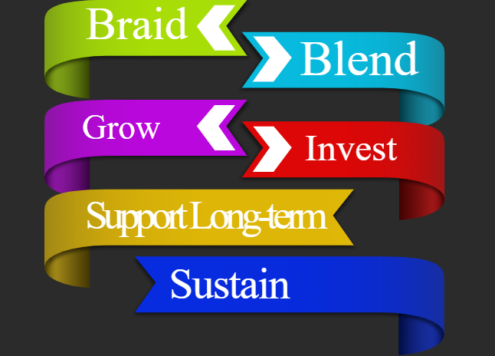
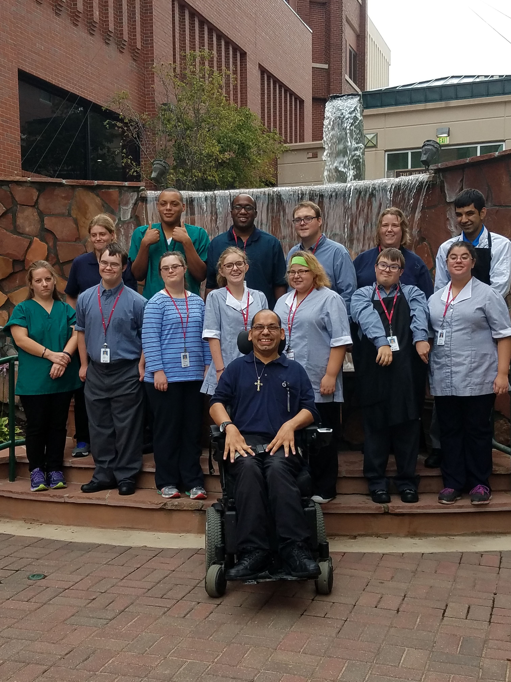
Sustaining a Program During Economic Hardships: UNMC I Nebraska Medicine’s
Project SEARCH Gains Partners and Diversifies Funding
Tara Harper, M.P.A., and Ian Froemming
Munroe-Meyer Institute UCEDD, University of Nebraska Medical Center, Omaha, NE 68198
ABSTRACT
MAXIMIZING LEARNING OPPORTUNITIES
Nebraska’s Home and Community-Based Services (HCBS) waiver programs for individuals with developmental disabilities (DD) drastically changed this year; leaving many individuals in limbo. State DD employment services transitioned to Vocational Rehabilitation (VR). This allowed the state to maximize federal funding. While it allows the state to serve more individuals waiting for services, many individuals are left vulnerable without services while VR attempts to increase their capacity to serve individuals with significant disabilities.
The UNMC I Nebraska Medicine Project SEARCH program has proven to be an effective model for adults with significant disabilities. Proposed changes in the state could have devastated the program. In an attempt to be proactive, stakeholders decided to diversify and braid funding. This year, a school district was added to make the program a mixed-site (transition students and adults). By employing diversified funding sources the program became self-sustainable once again. The expanded partnership doubles the number of interns from last year; thus allowing the site to maximize its job site rotations. With an average employment rate of 92% at this site, plans to replicate the mixed-site model across the state are already in the works.
GOALS
“Project SEARCH helped me quite a bit with everything from learning how to do office work to housekeeping. I got a great job working for MMI (Munroe-Meyer Institute) through Project SEARCH. I want to be around people more than being in bundles of people that do piece work after piece work after piece work everyday. Here I can do three different jobs in one day and get paid for it.”
~ Cheryl Lux
Project SEARCH Graduate and Internship Site Mentor
Goal One: Sustainability – Support interns post-graduation and throughout their career; which will set our program apart from transition only sites. Through Developmental Disability Services and Vocational Rehabilitation funding, the partner school district and adult providers will be able to teach prevocational skills along with helping interns to maintain employment long-term post graduation.
Goal Two: Employment Impact for Transition Students Using Follow-along Services and Job Coaching in Lieu of Traditional Day Services – In an effort to eradicate sheltered workshops in our state, more people with intellectual and developmental disabilities need to join the general workforce. Project SEARCH is a proven model for transition age students (i.e., 18 to 21 years of age) and individuals preparing to transition from sheltered workshops into competitive employment (i.e., 21 to 65 years of age). Implement the model with 100% integrity to assist interns in obtaining competitive employment, thus decreasing the need for sheltered workshops.
Goal Three: Network to Find Community Employment – With the growing number of people who are in need of employment it is important that we continue to network, find jobs of varying abilities and interests, and create pipelines to employment by collaborating with local businesses.
UNMC I NE MEDICINE
PROJECT SEARCH
Funding Formula
Braid – An offer was extended to the area public school district to become a partner of the UNMC I NE Medicine site. This allowed funds to be braided by having the school district reimburse the adult day service provider a third of the instructor’s salary. A fourth work-site skills trainer was also able to be hired. State Developmental Disability (DD) service dollars continue to fund the prevocational training program. Follow-along services after graduation are funded through Vocational Rehabilitation milestone payments.
Blend – Blended funding allowed resources to be provided at no cost to the interns and/or their families. The UCEDD continues to offer family resource coordination, technical assistance, and program administration. Unique internship rotations have been developed through collaborations at the Munroe-Meyer Institute (MMI); which have led to increased monetary program donations.
Grow – The age restriction was lifted last year in order to replicate a real work environment. With the additional work-site skills trainer and instructor’s salary support the class size increased to 14 interns this year. The site will max out at 20 interns by 2018.
Invest – The mixed-site concept allowed the Department of Education to invest in their students upfront, with the idea of decreasing the amount of government spending for the individual over time. Project SEARCH graduates obtain employment, whether part-time or full-time, and typically decline traditional day services. Otherwise they attend day services, however, on a part-time basis. The same thing is applicable to the adult DD clients who go through Project SEARCH.
Support Long-term – Long-term supports continue to allow graduates to maintain employment and/or seek advancement opportunities.
Sustain – Braided funding through DD, Vocational Rehabilitation, and the Project SEARCH partners allowed the program to once again become self-sustainable.
DISCUSSION
Advocacy to maintain DD funding is ongoing.
Permission was granted by each stakeholder before the school district was added.
Regular meetings have to be held to make sure everyone is on the same page.
Negotiations with partners have to occur before a MOU is revised.
Exercises to reenergize stakeholders need to take place to keep the team strong.
A sustainability plan has to be drafted and implemented prior to a new partner coming on board.
Opportunity to fundraise have brought with them additional funds to purchase assistive technology for interns.
With the larger class size, comes the opportunity for the UCEDD to provide reimbursable job coaching services as a subcontractor with the adult DD service providers.

